Slide 1
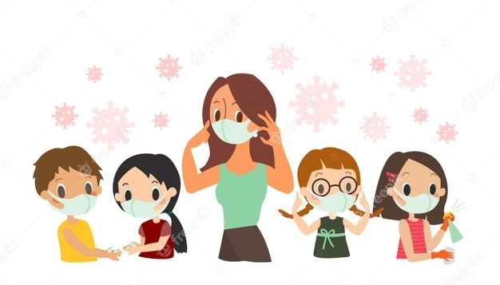
COVID-19 in children
Dr. Gaurav Mehta
MD (pediatrics)
Senior Specialist, Pediatric
Govt RDBP Jaipuria Hospital, Jaipur
(attached to RUHS College of Medical Sciences, Jaipur)
BASED on MOHFW & IAP GUIDELINES 2021
drgaurav.mehta@gmail.com (V. 2)

Slide 2
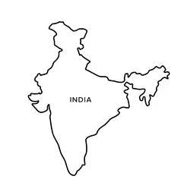
Total Cases
Total Deaths
31.15 Cr
55.15 L
Total Cases
Total Deaths
3.59 Cr
4.84 L
INDIA SPREAD
Worldometer.info & ourworldindata.org 11.01.22

Slide 3
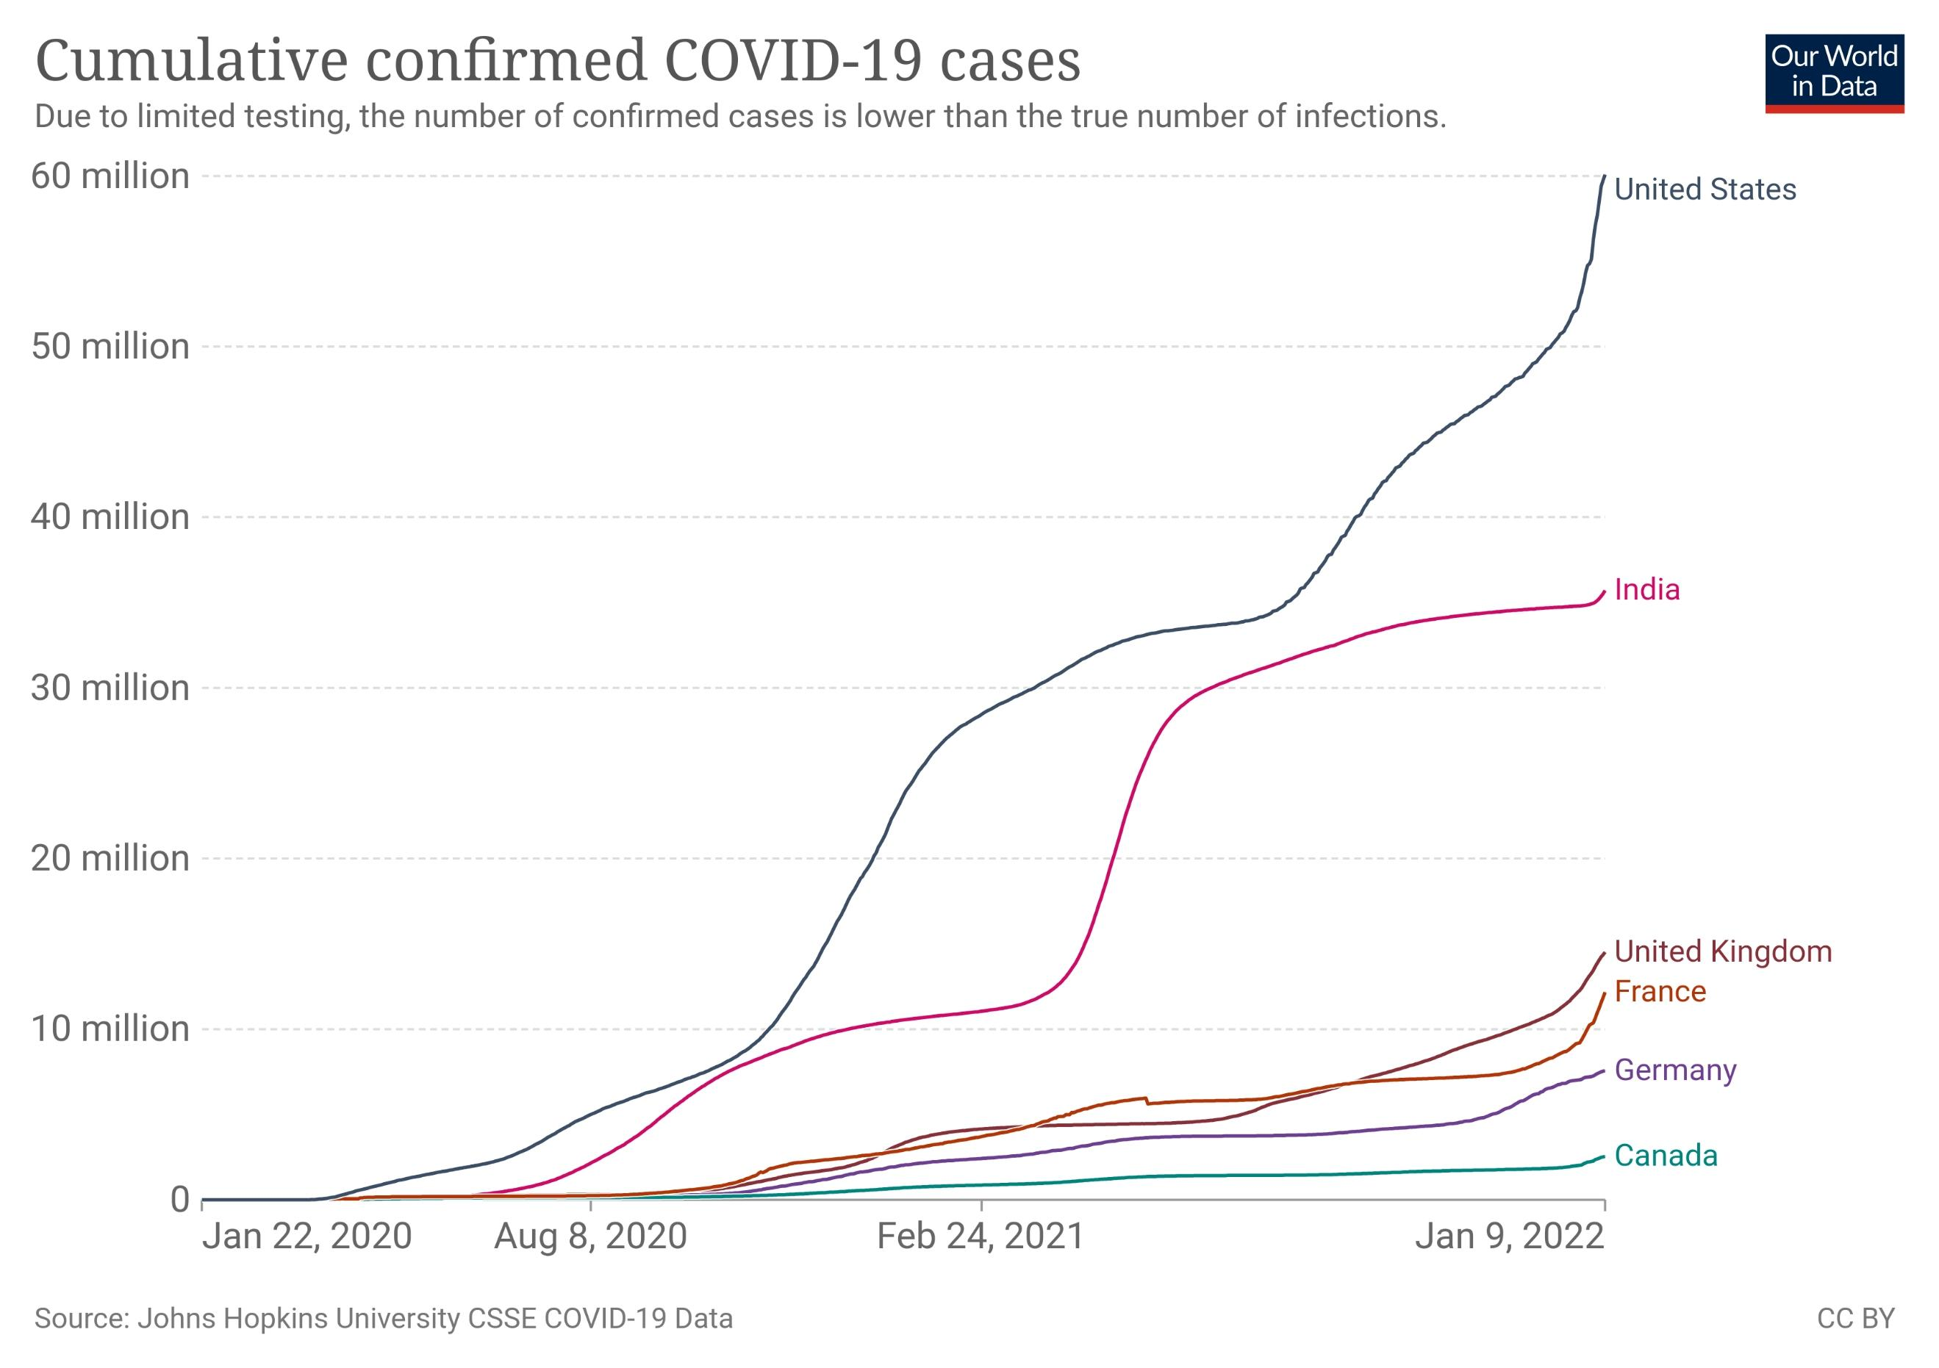

Slide 4
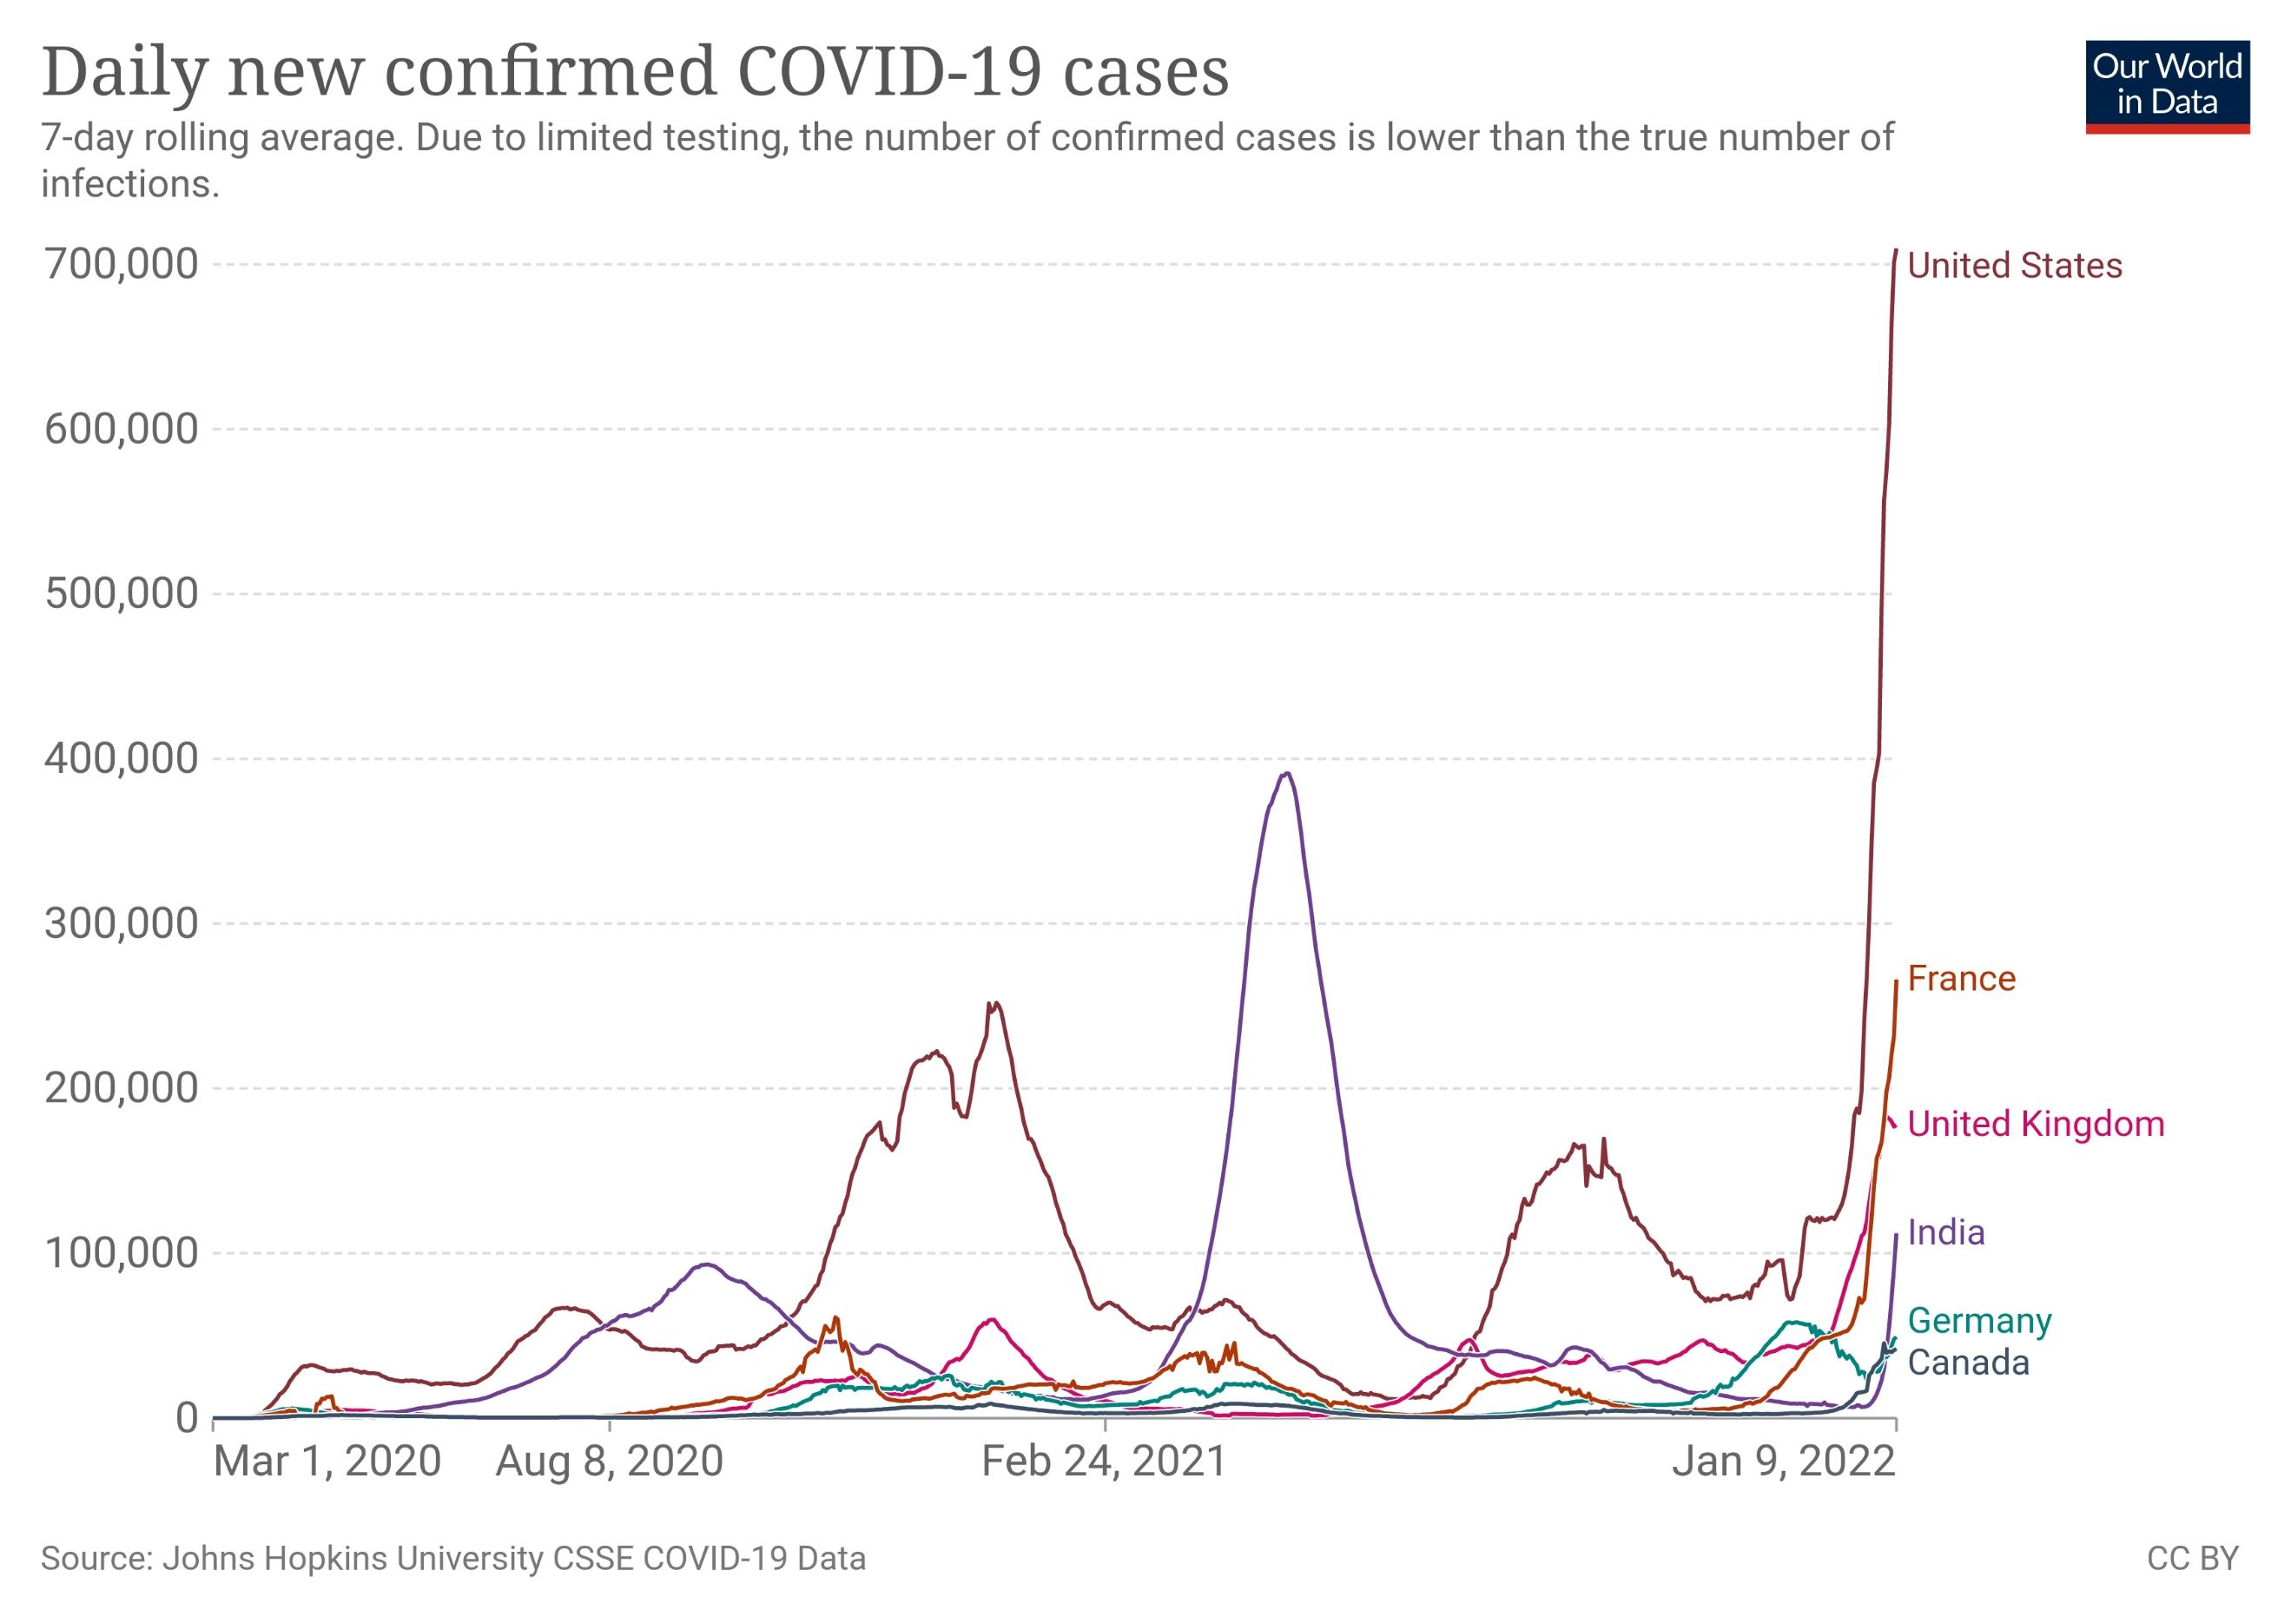

Slide 5
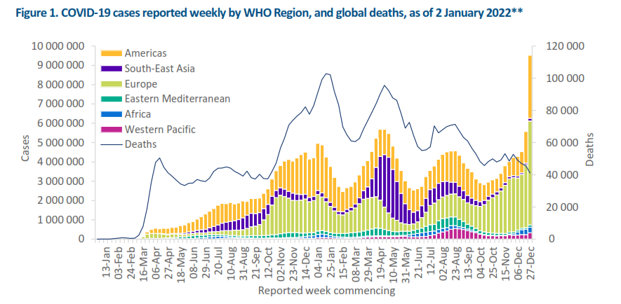
WHO COVID-19 weekly epidemiological update edition 73 Published 6 Jan 22
Notes:
Peaks of cases occurred at same time all over world.
Deaths are in proportion to the no. of cases
Deaths were more in proportion at the beginning of the pandemic
Deaths are low now, at time of Omicron (Omicron being Less pathogenic and more rapidly spreading strain?)

Slide 6
COVID-19 in Pediatric population
Epidemiology we need to learn first

Slide 7
COVID-19 :where are we standing?
 | World | India | Rajasthan
Total COVID-19 cases | 31.15 crore | 3.59 Crore | 9.82 Lakhs
Total Deaths | 55.15 lakhs | 4.84 Lakhs | 8, 974
Total Pediatric Cases
Total Pediatric Death | 11,470* (0.4% of 33.3 lakh death: 69% of JHU reported deaths) 58% deaths in 10-19 yrs. age 42% deaths in 0-9 yrs. age
JHU CSSE COVID-19 Data: accessed on 11-01-22
* data.unicef.org
Notes:
Highest cases of Covid-19 in India is in Maharashtra 66.4 lakh with death of 1.41 lakhs. Followed by Kerala 52 lakh cases 43170 death, than Karnataka and Tamil nadu

Slide 8
Pediatric COVID cases: Epidemiology
AAP reports in US, >8.5 million children have tested positive since the beginning of the pandemic (17.4% of all cases 486 Cr as on 6.01.22)
Till Dec 30th 325,000 pediatric cases. By January 6th 580,000 cases reported (78% increase mostly due to Omicron)
Rate of hospitalization:- 1.77%-4.3% of total COVID cases 0.1%-1.6% of childhood COVID-19 cases
Mortality:- 0.00-0.27% of total COVID deaths 0.00-0.02% of pediatric COVID cases
Data available to AAP as on 06.01.2022
Notes:
We're at the beginning of the 3rd wave of Covid-19 pandemic. A serosurvey conducted by PGIMER, Chandigarh among 2,700 children shows 71 per cent of them have developed antibodies. It shows children won't be affected disproportionately during the third wave," ANI quoted PGIMER Director Dr Jagat Ram as saying.

Slide 9
Pediatric COVID cases: Epidemiology
ICMR report <20 yrs. population comprised 11.73% of total cases in India.
Hospitalization rate was 10-20% and mortality rate was 0-0.7%
Rajasthan: Epidemiological analysis of COVID cases Report 2021 states 14% of all cases were pediatrics (0-19 yrs.) age
MIS-C cases have shown surge appearing nearly 2-6 weeks after covid infection
Notes:
We're at the beginning of the 3rd wave of Covid-19 pandemic. A serosurvey conducted by PGIMER, Chandigarh among 2,700 children shows 71 per cent of them have developed antibodies. It shows children won't be affected disproportionately during the third wave," ANI quoted PGIMER Director Dr Jagat Ram as saying.

Slide 10
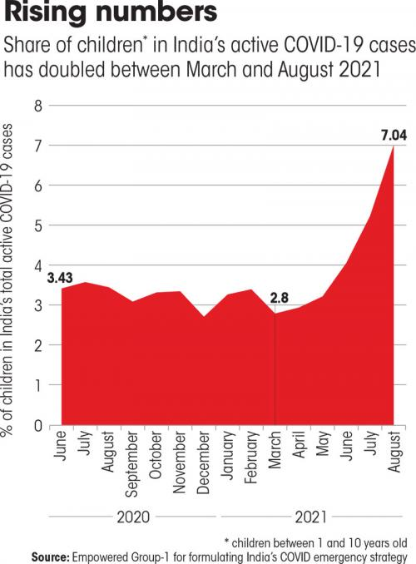
NITI Aayog meeting Data Show that the share of children aged 1-10 years in the total active covid19 cases has increased steadily from 2.80% in March 2021 to 7.04% in August 2021
For every 100 active cases, around 7 are children
7.04%
3.43%
2.8%
June 2020
February 2021
August 2021

Slide 11
Delta main cause of COVID-19 in children
As per NITI Aayog meeting, The Sero-prevalance, positive among children in the age 6-9years age group was 57-58% and in age group 10-17 was 61.6%- lower than entire population 67.6%
A serosurvey study by PGIMER, Chandigarh in 2700 children of age 6-18 years, 71% children tested positive for antibodies in Chandigarh.
The recent study from 583 covid cases aged 0-18 years in 8 Indian states from March to June 2021, >50% were seropositive
Kappa variant- reported in Sept 2020- 9.96% cases
Delta variant- Reported in Oct. 2020- 65.82% cases
Alfa variant- reported in Jan-March 2021- 6.83% cases
B.1.36 variant- 4.68% cases
B.1.1.529 (Omicron) variant: appears to be main variant in current 3rd wave
Notes:
A serosurvey study in 14 districs of rajasthan showed 91% population found to have antibody now

Slide 12
COVID-19 in Children in 3rd wave
Increased number of infections in children
Children going out- Schools reopened, Parks, Malls reopened.
Transmission from adults
More infectious variant virus ( entire household affected- delta and now Omicron)
Expecting large number of children in 3rd wave illness
However, disease in children is milder than adults (4-5% will need hospitalization )
COVID vaccines for Pediatric age groups in India is available just now and that too for age group 15-18 yrs. only (3rd wave already started)
Need of Triaging if number increases
Infrastructure is already in place

Slide 13
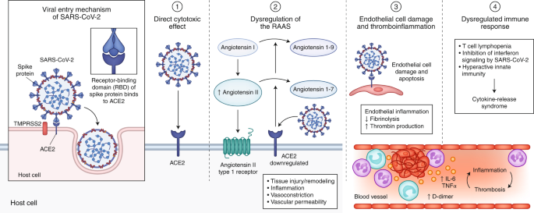
Pathogenesis of COVID-19 infection

Slide 14
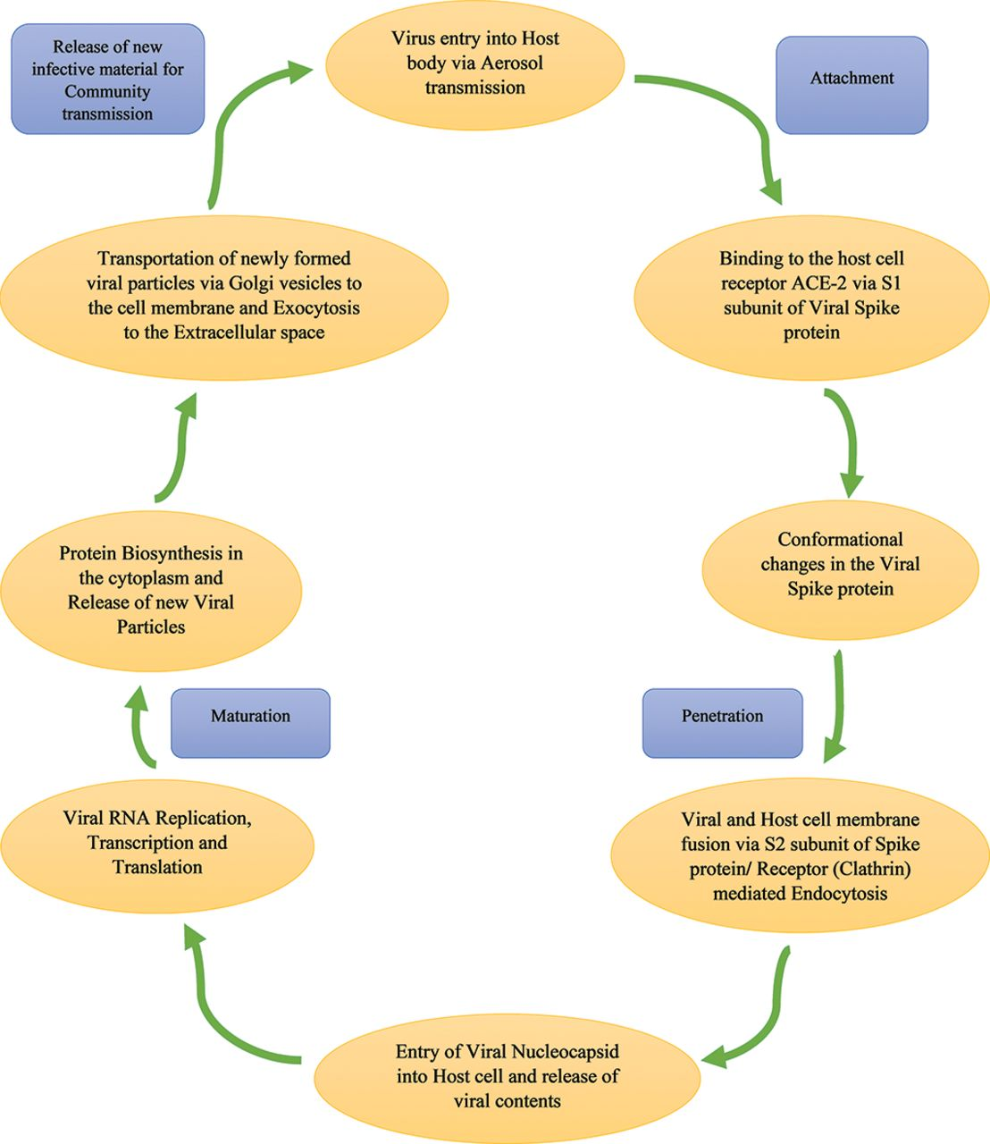
Pathophysiology of COVID 19

Slide 15
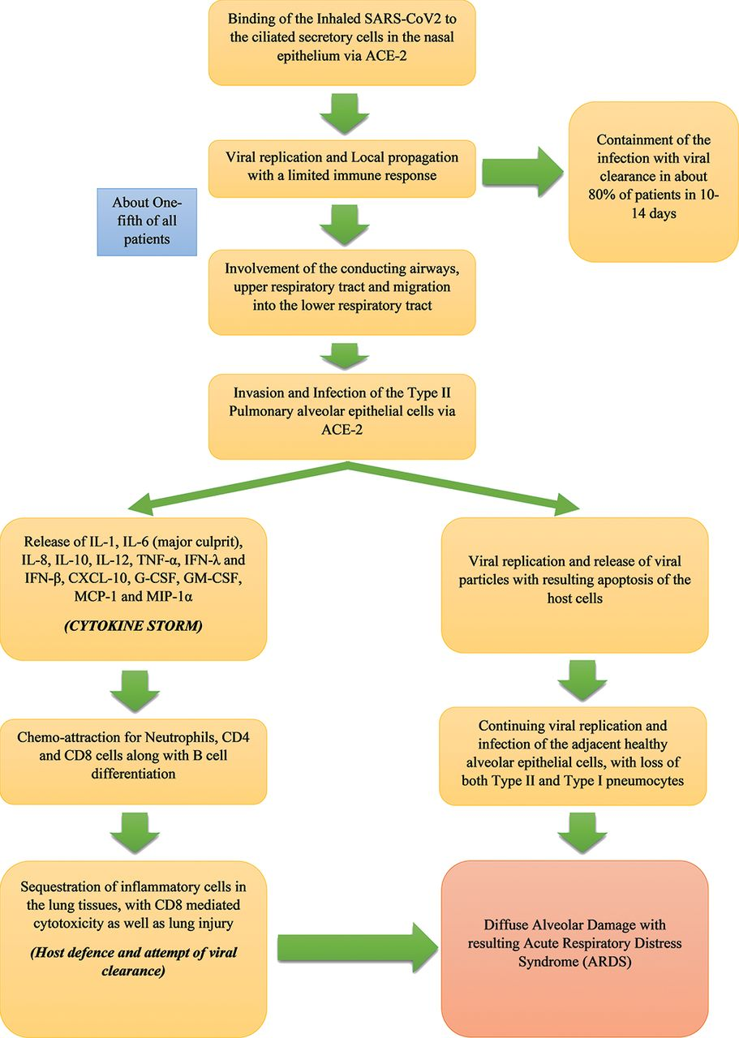

Slide 16
Pathophysiology of SARS-CoV-2

Slide 17
Clinical Presentation
Of COVID-19 in children

Slide 18
60-70% children are asymptomatic
30-40% children have symptoms
Hospitalization rate 5-10% of all symptomatic
ICU care
only 1-2 % of all symptomatic children
(this was in 2nd wave, now it seems to be 2-4 %)
Notes:
Mortality in pediatric COVID is negligible. Up to 0.00-0.07%
Mortality mostly occurring in COVID children with CHD/CKD/Immunocompromised/Syndromic

Slide 19
Pediatric COVID: Who are at risk?
Children with a pre-existing major disease might be at higher risk of getting severe illness from COVID-19.
a heart, kidney or liver disease
malignancies.
Children who might also be at increased risk for severe illness from COVID-19.
obesity,
diabetes,
asthma or chronic lung disease,
sickle cell disease, or
immunosuppression

Slide 20
Why Pediatric Population is less Infected?
The reasons may be due to low expression of ACE 2 and TMPRSS2 receptor,
robust innate immunity and weak adaptive immunity,
decrease expression of toll like receptors (TLR) and
increase regulatory T cells and greater capacity of endothelial regeneration.

Slide 21
Which child is a COVID-19 suspect?
•
At this time COVID-19 is the commonest cause of acute illness in
children and adults
Symptoms are non specific and like any other viral illness
Whether or not contact history is present
Fever / Sore throat/ Cough/Malaise/ Fatigue/Breathlessness either
alone or in combination
Loss of sense of smell/ taste (older children)/ poor feeding in infant
Diarrhoea, vomiting and abdominal pain
Rash, shock, seizures, drowsiness
Asymptomatic close/ household contact of COVID-19 patient
•
•
•
•
•
•
•

Slide 22
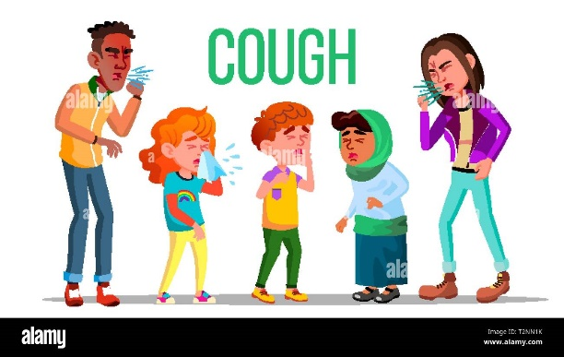
Clinical Features
Common symptoms includes
Fever
Sore throat
Cough
Fatigue
Myalgia
Rhinorrhea
Diarrhea
Poor feeding
Less common symptoms
Breathlessness/shortness of breath
Loss of taste or smell (in children over eight years old)
Rash
Red or pink eyes
Swollen and/or red lips, tongue, hands or feet
Gastrointestinal symptoms like diarrhea, pain abdomen, vomiting
Notes:
MIS-C: Multisystem inflammatory syndrome in children or PIMS-TS: Pediatric Inflammatory Multisystem Syndrome

Slide 23
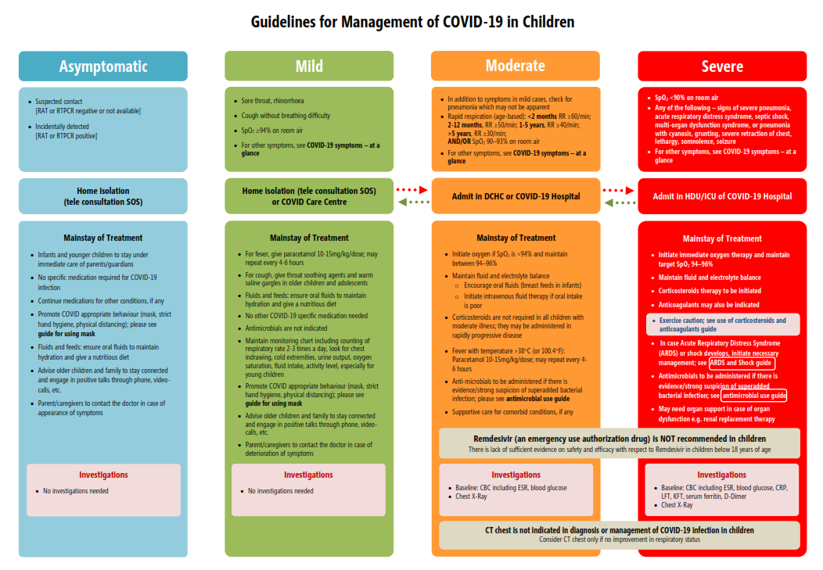

Slide 24
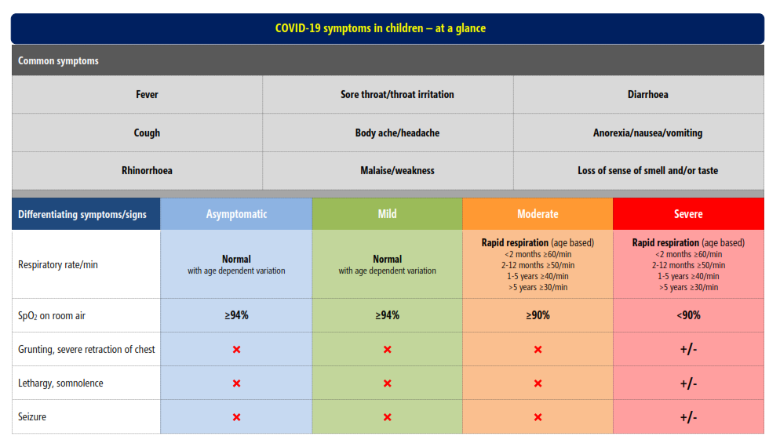
MoHFW guidelines for management of COVID in children 18 June 2021

Slide 25
Omicron variant

Slide 26
Omicron (B.1.1.529) Variant
First detected in specimens collected on November 11, 2021 in Botswana and on November 14, 2021 in South Africa
Declared as new SARS-CoV-2 variant of concern and named by WHO- Omicron B.1.1.529
Spread more easily than the original SARS-CoV-2 virus
More evidence is emerging that the Omicron coronavirus variant is affecting the upper respiratory tract, causing milder symptoms than previous variants causing more lung damage
resulting in a “decoupling” in some places between soaring case numbers and low death rates (WHO)

Slide 27
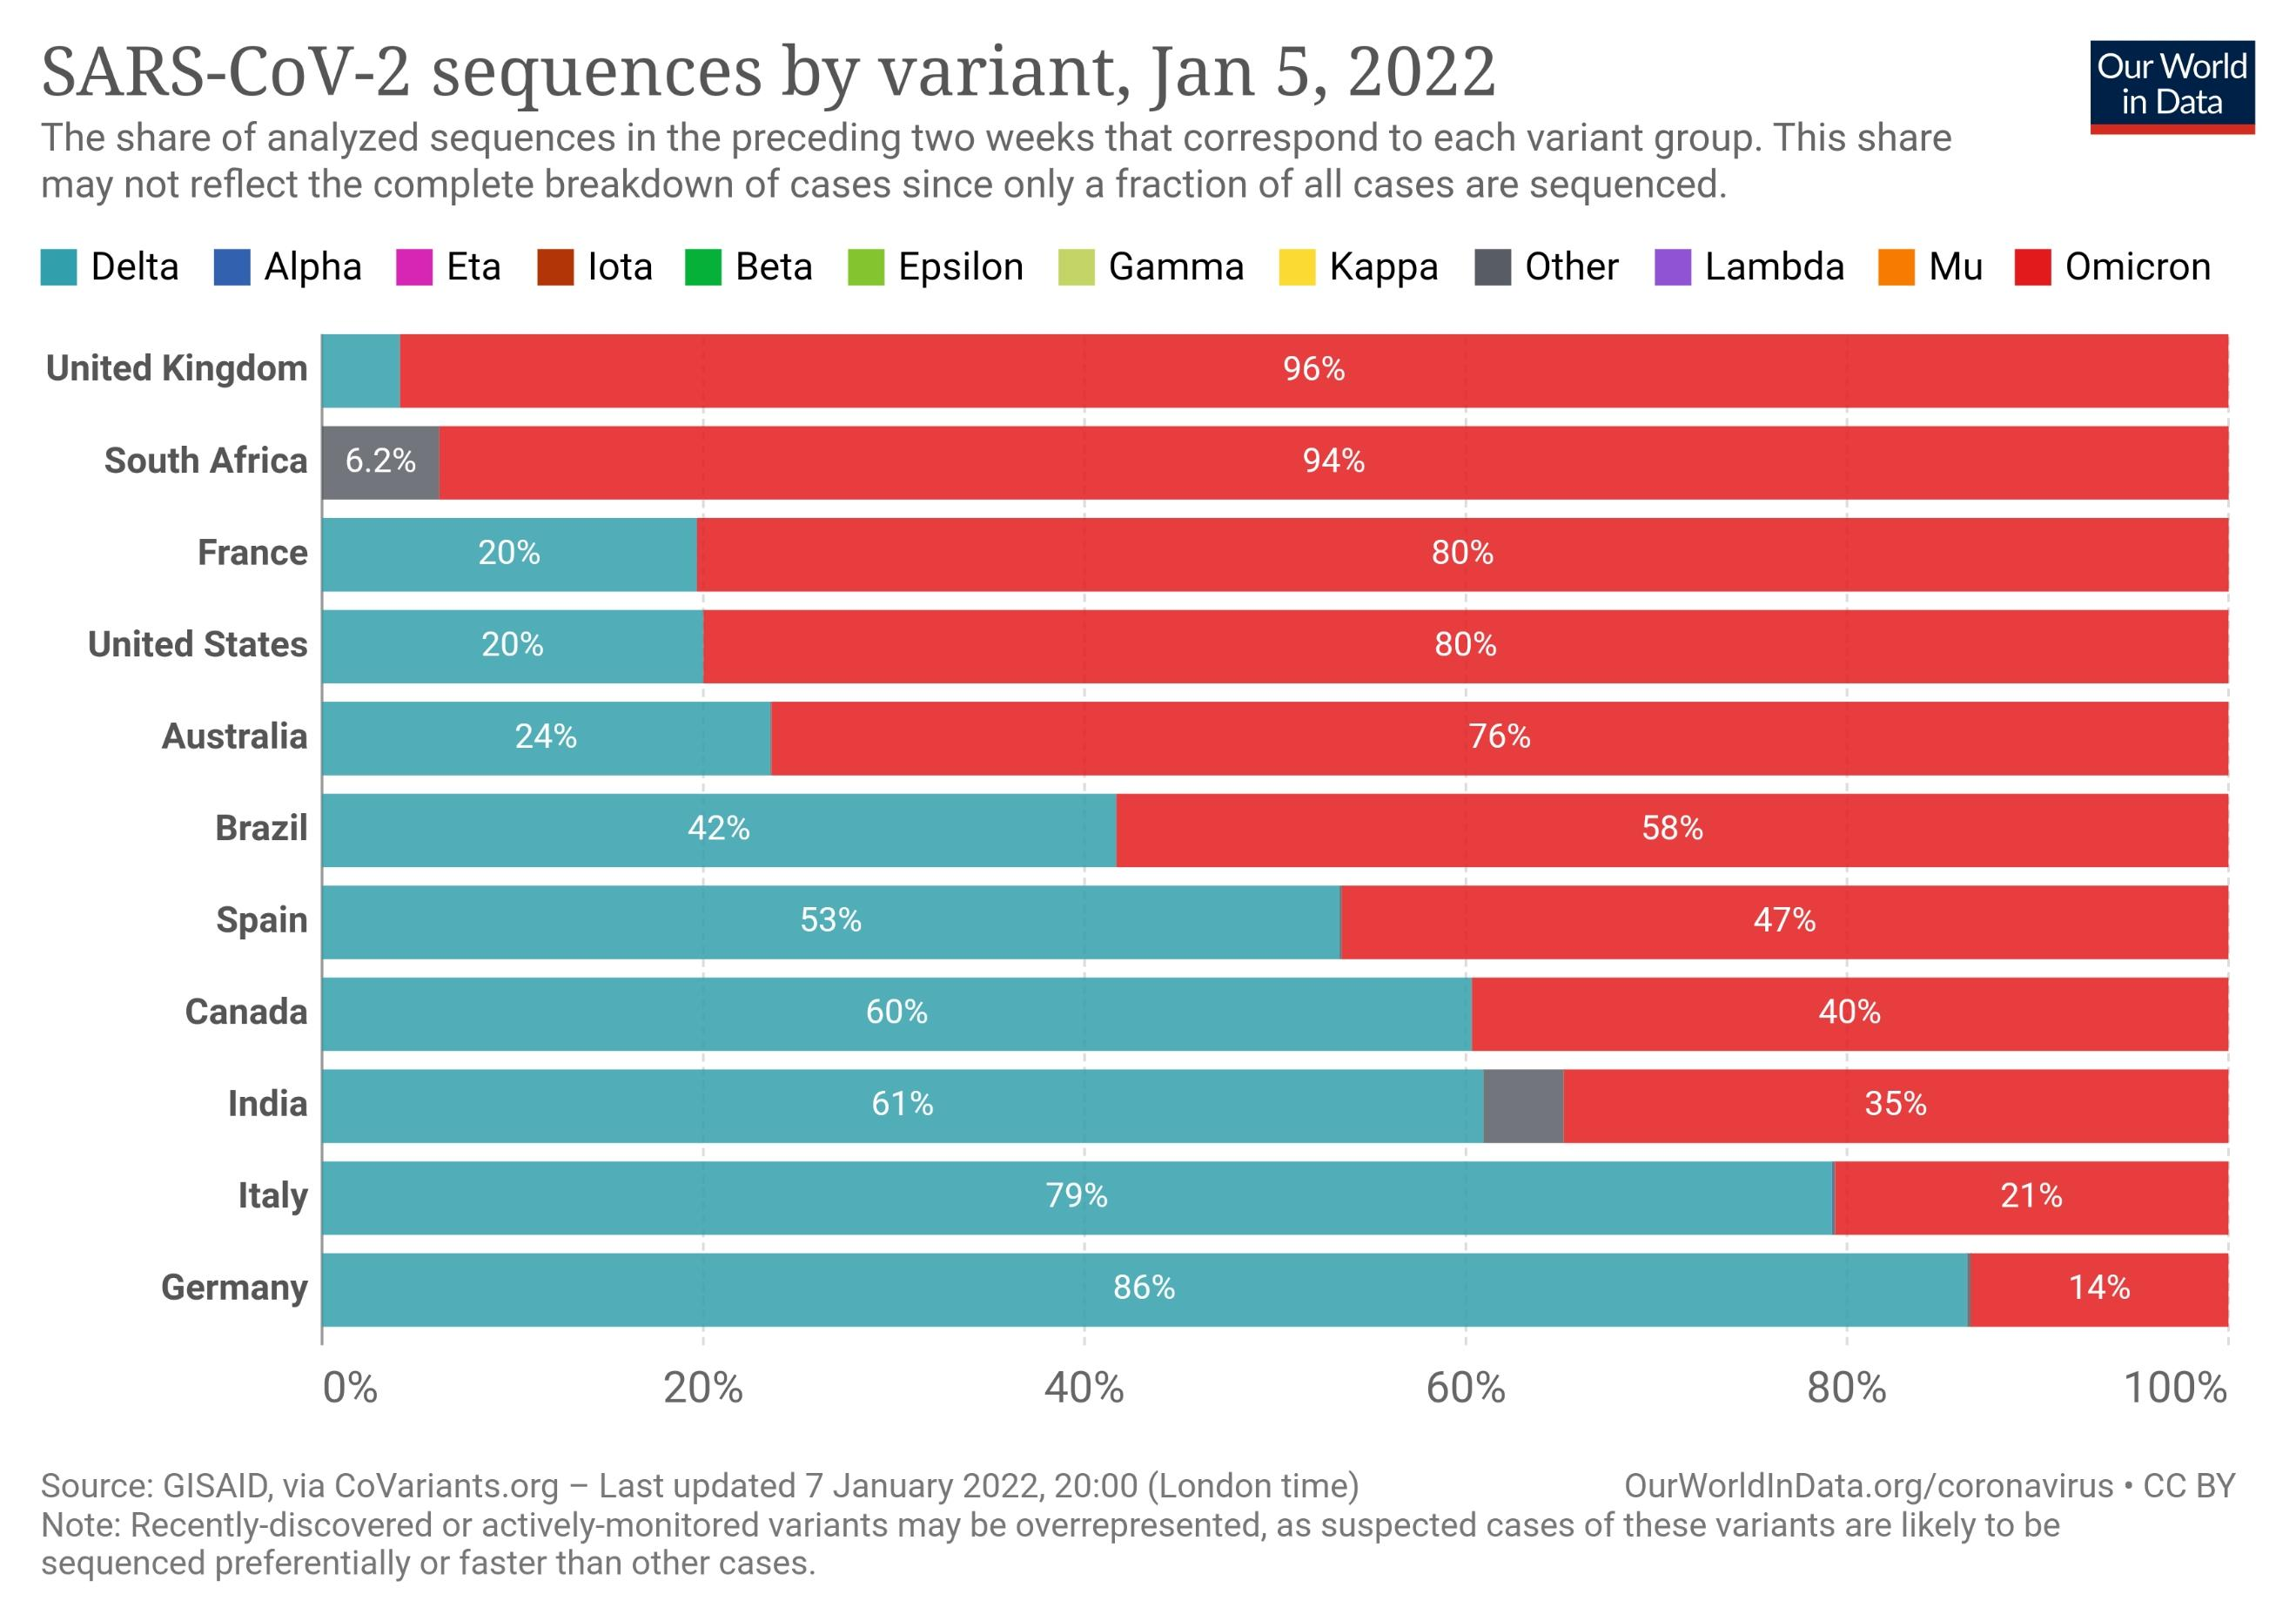
In India, Delta is still a major varients.
In view of rising no. of cases, it can be trouble some again

Slide 28
Omicron: More data is required to know
How much infection, reinfections and breakthrough infections occurs in people who are fully vaccinated If it causes more severe illness or death than infection with other variants.
to determine how well existing treatments for COVID-19 work on omicron
vaccine prevention against severe illness, hospitalizations, and deaths due to infection with the Omicron variant is yet to determine

Slide 29
Omicron: sign and symptoms
Most common symptoms
fever, cough, tiredness, loss of taste or smell.
Less common symptoms
sore throat, headache, aches, pains, diarrhoea, a rash on skin, discolouration of fingers or toes
red or irritated eyes.
Serious symptoms
Difficulty breathing or shortness of breath, loss of speech or mobility, or confusion or chest pain.

Slide 30
Omicron: sign and symptoms
It is Unlikely there is any difference in symptoms between the Omicron variant and previous versions.” most symptoms are same.
Some symptom differences: a scratchy or sore throat along with nasal congestion, a dry cough and muscle pain, especially low back pain.
Less likely than earlier variants to cause a loss of taste and smell
Git symptoms - Nausea,” “diarrhea” and “fatigue” are same as in other Variants.
Nausea and low back pain are typically more than in other Variants
Notes:
Early to say that there’s any symptoms difference
Some symptom differences have emerged from preliminary data, but experts are not certain they are meaningful
All these are just reports and not proven in clinical trials

Slide 31
Omicron: difference from other variants
Omicron seems to have a shorter incubation time than other variants- 3 days compare to delta and other variants with 4-6 days IP
Effectiveness of vaccines:
Vaccine effects on omicron prevention is still not understood
Current vaccines remain effective against severe disease and death.
Vaccinated Omicron patients complain of headaches, body aches and fever — “like a really bad cold
Unvaccinated people have the same shortness of breath, cough and flulike symptoms like with Delta and other variants
Notes:
Reinfections with Omicron Ie, people who have previously had COVID-19

Slide 32
Effectiveness of prior SARS-CoV-2 infection: there may be an increased risk of reinfection with Omicron than other variants
Effectiveness of current tests: The widely used PCR tests continue to detect infection, including infection with Omicron
Effectiveness of current treatments: Corticosteroids and IL6 Receptor Blockers will still be effective for managing patients with severe COVID-19.
Other treatments will be assessed to see if they are still as effective Against the Omicron variant.

Slide 33
Omicron: sign and symptoms in children
Fever, cough, sore throat and throat pain are most commonly seen in kids as per the expert
Although children tended to have mild symptoms, they were 20 percent more likely to be hospitalized during the Omicron wave compared with the first wave.
Croup is a newer symptom seen in children affected with Omicron strain.
Seems to occur so because of more involvement of upper respiratory tract involvement in omicron

Slide 34
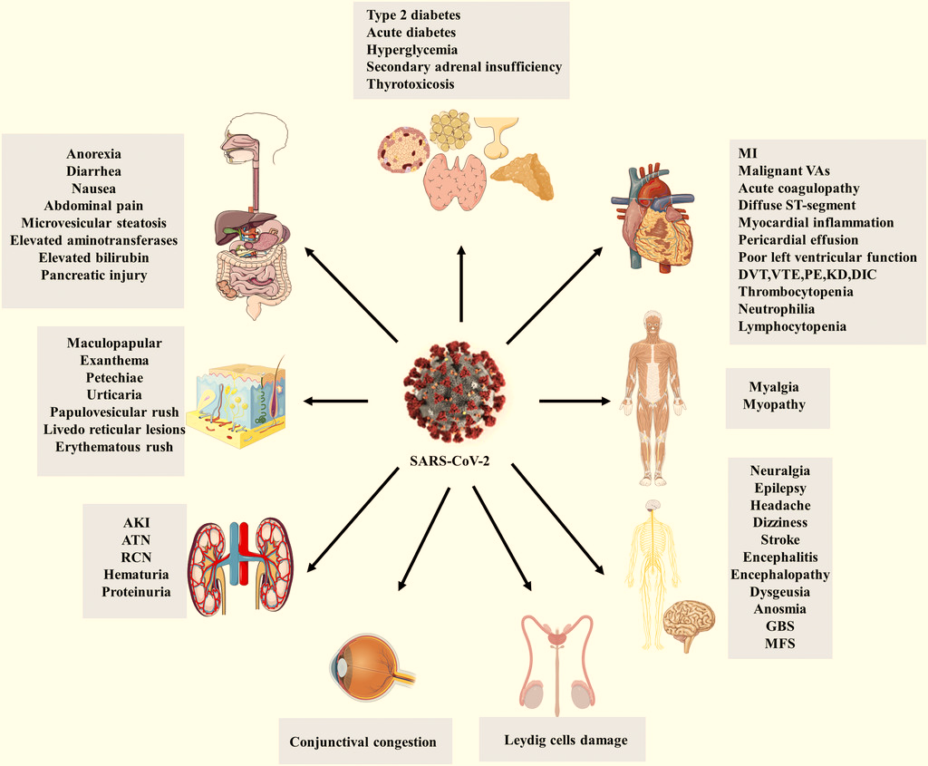
Extrapulmonary manifestations of SARS-CoV-2.
Details of pathophysiology pl read: https://www.ajtmh.org/view/journals/tpmd/103/5/article-p1783.xml

Slide 35
System | Clinical Manifestations
Heart | MI, non-ischemic fulminant myocarditis, CMP,
Vascular system | VTE (pulmonary embolism, DVT) Kawasaki Disease Coronary artery aneurysm
Digestive system | Diarrhea, loss of appetite, nausea, vomiting, abdominal pain, GI bleeding,
System | Clinical Manifestations
Liver and Gall bladder | Elevated ALT, AST, ALP, GGT, Bilirubin
Cytokinin storm, hypoxia, ischemia | leads to ischemia, hypoxia, ARDS, and systemic Inflammatory response syndrome (SIRS). spleen atrophy and lymph node necrosis
Pancreas | Acute pancreatitis

Slide 36
System | Clinical Manifestations
Musculo-skeletal system | limb pain critical illness myopathy, acute quadriplegic myopathy, thick filament myopathy, and necrotizing myopathy Myalgias (50%) Rhabdomyolysis myositis and myasthenia gravis
Endocrine system | thyroid function abnormalities (Thyrotoxicosis f/by hypothyroidism ) infection can cause ketosis per se in nondiabetic persons and may increase the risk of ketoacidosis in patients with diabetes Acute adrenal insufficiency
System | Clinical Manifestations
CNS | Dizziness, Headache multiple cerebral infarctions, acute ischemic stroke impaired consciousness or delirium Encephalitis, encephalopathy and confusion Stroke Guillian Barre syndrome Miller Fischer Syndrome Olfactory and Taste Dysfunction

Slide 37
System | Clinical Manifestations
Ocular system | Conjunctivitis Redness and excessive tearing dry eyes, foreign body sensation, and blurred vision
Urinary System | Chronic kidney disease AKI Proteinuria (63%) Elevated levels of serum creatinine and urea nitrogen (19-27%)
Reproductive system | total testosterone (T) was lower, FSH, Estrogen, Progesterone levels were same Serum luteinizing hormone (LH) was significantly higher Higher Prolactine

Slide 38
Investigations
in pediatric COVID-19 cases

Slide 39
Testing of suspect patients..
•
Whom to test
•
•
Ideally all where we suspect COVID-19 (to avoid transmission to other household)
But due to the load on labs and prolonged TAT, may be deferred in
asymptomatic contacts AND children with mild symptoms/ no comorbidities#
and known contact (but isolation is mandatory)
Before any procedure/ hospitalization
•
•
Comorbidities of significance which may indicate higher risk of severe disease
•
•
•
•
•
Chronic kidney/ heart/liver/ lung disease/ diabetes/ neuro disability
Morbid obesity
Current malignancy
Severe malnutrition
Immunocompromised state

Slide 40
When and which test?
•
•
As soon as symptoms test
RTPCR in NP/OP swab
(gold standard, but 30% false negative)
•
Sensitivity 71% and specificity 94%
Xpert Xpress, TruNAT and 'ID now' give results within 1 hour
•
Many factors can interfere with the results such as procedure and handling of the material or even to the viral load of the sample ( area of the swab collected, duration of symptoms, and disease severity)
•
RTPCR single negative test in an individual with a characteristic clinical picture [ high pre test probability] should not discard the possibility of COVID-19
Timing of repetition of Such RT-PCR test is not clear yet.
Notes:
ID now: (abbott) portable reliable and rapid molecular test gives result in 13 min. portable machine

Slide 41
RT-PCR contd…
In area of Higher disease burden, (prevalence of 25%) the false negative rate after four RT-PCR test is <1% and (at prevalence of 50%) the false negative rate after four RT-PCR test is <2.5% [doi: 10.1016/j.rmcr.2020.101192]
Even after repeat RTPCR test continue to be negative despite symptoms highly suggestive of COVID-19 , patient must be treated as a case of COVID-19 without further waiting for more tests. HR CT thorax may be advised in reaching correct diagnosis
Cycle threshold (CT) value of the RT PCR does not correlate with severity of disease, depends lot on how sample is collected
ICMR: CT value <35 COVID + and >35 is COVID negative

Slide 42
When and which test?
Rapid Antigen Test (RAT) in nasopharyngeal swab
Coviself, Panbio (Abbott) Covifind… cheap, but low sensitivity (34%-80%), good specificity with RT-PCR Negative test, clinical suspicion high, go for RTPCR
A positive test does not need confirmation
COVID-19 antibodies also if suspicion of MIS-C or if symptoms last for more than 1 week Interpret a positive test in context of the clinical setting also
Notes:
ID now: (abbott) portable reliable and rapid molecular test gives result in 13 min. portable machine

Slide 43
ICMR guidelines for RTPCR testing in 2nd wave
RTPCR test must not be repeated in any individual who has been tested positive either by RTPCR or RAT
No testing is required for covid-19 recovered individuals at time of hospital discharge in accordance with discharge policy of MoHFW*
Need of RTPCR for individuals travelling inter state domestic travels may be removed to reduce the burden on labs.
Non-essential travel and interstate travel of symptomatic individuals should be avoided to reduce the risk of infection
NO need to repeat RTPCR after 14 days of quarantine
* although this is advisory and not followed in states like Rajasthan. All interstate travels were requiring COVID negative report

Slide 44
Diagnostic algorithm
Suspected COVID
Antigen
test
in
nasopharyngeal swab
Negative
RT PCR
Positive
Negative
COVID confirmed
Positive
Rule out other illnesses Repeat RT PCR if available Antibody tests
CT scan if protracted symptom
Treat as probable COVID-19

Slide 45
Interpretation of Diagnostic Tests in COVID-19

Slide 46
Chest X-ray
Chest X—ray should be considered in patients with COVID-19 presenting with moderate-to-severe acute respiratory illness symptoms.
sensitivity and specificity is less, a negative chest radiograph does not exclude pulmonary involvement.
Commonest findings are
Bilateral distribution
peripheral and/or subpleural GGOs
and/or consolidation.

Slide 47
What is the role of CT chest in children with COVID-19?
CT chest is more sensitive than CXR but involves cost, need for sedation and radiation exposure
Should not be used for screening and diagnosis.
Not indicated in
• Asymptomatic/Mild disease
• Prolonged fever unless lower respiratory tract involvement suspected
Remember CT-Chest is not required to initiate treatment of patients with Hypoxia
It is also not required to asses response to treatment
HRCT done is first week of illness MIGHT underestimate the extent of lung involvement

Slide 48
What is the role of CT chest in children with COVID-19?
CT Thorax indicated in
Clinical suspect COVID-19 with protracted symptoms but negative RT PCR
Acutely sick child with breathlessness where need to determine cause of illness and triage is needed
Known severe COVID-19 with deterioration (to determine the cause of deterioration)
Following resolution of the acute infection CT may be needed to assess for development and/or evolution of fibrotic lung disease in patients with persistent alterations in pulmonary function tests

Slide 49
Radiologic manifestations of COVID-19
X-ray chest common findings in children are:
Bilateral distribution
peripheral and/or subpleural GGOs
and/or consolidation
Common findings in CT chest in children are:
Ground glass opacities/nodules
Consolidation with a surrounding halo sign
Bilateral or local patchy shadowing
Interstitial abnormalities

Slide 50
Other investigations
Evaluate all admitted children with CBC, LFT, RFT, CRP, d –dimer, chest x-ray.
Send blood culture if bacterial co-infection is suspected.
Repeat laboratory investigation after 48-72 hours if clinically indicated.
Possible tropical infections like malaria, typhoid, dengue, scrub typhus and Leptospira to be ruled out
Selected patients with shock or cardiac involvement may need Echocardiography, ECG and cardiac biomarkers (troponin, CK, CK MB and NT-proBNP)
ABG, Lactate, Ferritin, Procalcitonin, Coagulation profile in severe and critically ill patients.
Notes:
NT-ProBNP: N terminal Pro BNP

Slide 51
Common Laboratory findings in children
In a recent meta-analysis of 66 studies in children that included 9335 children (0 to 19 years) with documented SARS-CoV-2 (including 1208 with MIS-C), the following laboratory abnormalities were (mean proportion):
Elevated CRP – 54%
Elevated serum ferritin – 47 %
Elevated LDH– 37 %
Elevated D-dimers – 35 %
Elevated procalcitonin – 21 %
Elevated ESR– 19 %
Elevated leukocytes – 20 %
Lymphocytopenia – 19 %
Lymphocytosis – 8 %
Elevated serum ALT – 30 %
Elevated CPK MB – 25 %

Slide 52
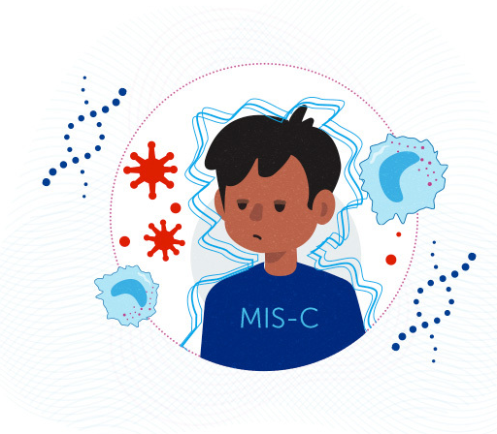
Multisystem Inflammatory Syndrome in Children (MIS-C)

Slide 53
MIS-C: An Overview
1
2
May show up weeks after COVID-19 infection
Appears to be rare in children
3
4
Causes inflammation across multiple organs, Including
Produce varying symptoms in children, but they can include
Heart
Lung
Kidney
Brain
Skin
Eyes
Gastrointestinal
Fever
Abdominal Pain
Vomiting
Diarrhea
Feeling extra tired
Neck Pain
Blood shot eyes
Skin rash
Notes:
Multisystem inflammatory Syndrome in Children MIS-C
It is a new syndrome in children characterized by unremitting fever >38◦C and epidemiological linkage with SARS-CoV-2

Slide 54
Multisystem Inflammatory Syndrome in Children (MIS-C)
When to suspect?
Any child with fever more than 3 days in this epidemic
Especially with GI, mucocutaneous , neurologic and cardiac manifestations
Treat as medical emergency- admit in HDU/ICU, if treatment of cardiac dysfunction, coronary involvement, shock or multi-organ dysfunction syndrome (MODS)
Rule out acute COVID-19 and other infections
Tropical fevers (malaria, dengue, scrub typhus, enteric fever)
Toxic shock syndrome (staphylococcal or streptococcal)
Bacterial sepsis

Slide 55
Multi System Inflammatory Syndrome in Children (MIS-C)
It is a new syndrome in children characterized by unremitting fever >38◦C and epidemiological linkage with SARS-CoV-2
Diagnostic criteria (WHO)
Children and adolescents 0–18 years of age with fever ≥3 days
And any two of the following:
Rash or bilateral non-purulent conjunctivitis or muco-cutaneous inflammation signs (oral, hands or feet)
Hypotension or shock
Features of myocardial dysfunction, pericarditis, valvulitis, or coronary abnormalities (including ECHO findings or elevated Troponin/NT-proBNP)
Evidence of coagulopathy (PT, PTT, elevated D-Dimers)
Acute gastrointestinal problems (diarrhoea, vomiting, or abdominal pain)
And elevated markers of inflammation such as ESR (>40 mm), C-reactive protein (>5 mg/L), or procalcitonin
And no other obvious microbial cause of inflammation, including bacterial sepsis, staphylococcal or streptococcal shock syndromes
And evidence of recent COVID-19 infection (RT-PCR, antigen test or serology positive), or likely contact with patients with COVID-19

Slide 56
MIS-C: WHO diagnostic Criterias
Children and adolescents 0–18 years of age with fever ≥3 days and
1. Rash or bilateral non-purulent conjunctivitis or muco-cutaneous inflammation signs (oral, hands or feet)
2. Hypotension or shock
3. Features of myocardial dysfunction, pericarditis, valvulitis, or coronary abnormalities (including ECHO findings or elevated Troponin/NT-proBNP)
4. Evidence of coagulopathy (PT, PTT, elevated D-Dimers)
5. Acute gastrointestinal problems (diarrhoea, vomiting, or abdominal pain)
Any Two of the following
1
Notes:
All 4 criteria should be matched in a child age 0-18 yrs. and with >3 days history of fever

Slide 57
MIS-C: WHO diagnostic criterias
elevated markers of inflammation such as ESR (>40 mm), C-reactive protein (>5 mg/L), or procalcitonin
and
2
no other obvious microbial cause of inflammation, including bacterial sepsis, staphylococcal or streptococcal shock syndromes
and
3

Slide 58
MIS-C: WHO diagnostic criterias
evidence of recent COVID-19 infection (RT-PCR, antigen test or serology positive), or likely contact with patients with COVID-19
4

Slide 59
Multisystem Inflammatory Syndrome in Children (MIS-C)
3 types of MIS-C:
MIS-C without shock
MIS-C with shock/MODS
MIS-C with Kawasaki Disease (KD) phenotype
MIS-C with Kawasaki Disease (KD) phenotype is characterized by fever, conjunctival redness, oropharyngeal findings (red and/or cracked lips, strawberry tongue), rash, swollen and/or erythematous hands and feet and cervical lymphadenopathy

Slide 61
Tier 1 &Tier 2 investigations for MIS-C
Tier 1 tests (may be done at Covid Care Centre, Dedicated Covid Health Centre):
CBC,
complete metabolic profile (LFT/KFT/blood gas/glucose),
CRP and/or ESR,
SARS-CoV-2 serology and/or RT-PCR,
blood culture
Positive Tier 1 screen (both of these should be present):
1. CRP >5 mg/L and/or ESR >40 mm/hour;
2. At least one of these: ALC <1000/µL, platelet count <150,000/µL, Na <135 mEq/L, neutrophilia, hypoalbuminemia
Tier 2 tests (may be done at Dedicated Covid Hospital):
Cardiac (ECG, echocardiogram, BNP, troponin T);
inflammatory markers (procalcitonin, ferritin, PT, PTT, D-Dimer, fibrinogen, LDH, triglyceride, cytokine panel)
blood smear;
SARS-CoV-2 serology
* Common tropical infections include malaria, dengue, enteric fever, rickettsial illness (scrub typhus), etc.

Slide 62
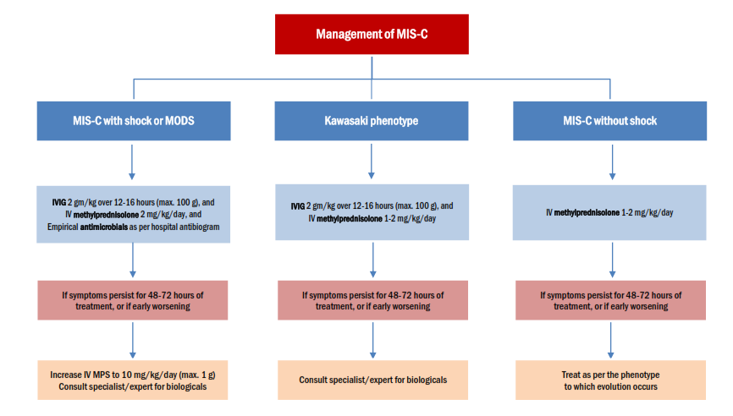

Slide 63
MIS-C: treatment
MISC-C without shock: iv methylprednisolone 1-2 mg/kg/day
If symptoms persists for 48-72 hrs. of treatment or if early worsening treat as per phenotype to which evolving
MIS-C with SHOCK/MODS: IvIG 2 gm/kg over 12-16 hours (max. 100 grams) and + iv Methylprednisolone 2mg/kg/day + empirical Antibiotics as per hospital antibiogram
IvIG to be given slower (over 48hrs) in children with Cardiac failure/fluid overload
If symptoms persists for 48-72 hrs. of treatment or if early worsening increase iv Methylprednisolone to 10-30 mg/kg/day (max. 1 g) for 3-5 days Consult specialist/experts for biologicals

Slide 64
MIS-C: treatment
MIS-C with Kawasaki Disease phenotype: IvIG 2 gm/kg over 12-16 hours (max. 100 grams) and + iv Methylprednisolone 1-2mg/kg/day
IvIG to be given slower (over 48hrs) in children with Cardiac failure/fluid overload
If symptoms persists for 48-72 hrs. of treatment or if early worsening consult specialist/experts for biologicals
Failure of all the above treatment needs expert consultation for biologicals- Anakinra, Tocilizumab and Infliximab are few options

Slide 65
MIS-C: treatment
Taper steroids over 2-3 weeks with serial CRP and clinical monitoring
Aspirin 3-5 mg/kg/day, maximum 75(81) mg/day in all children for 4-6 weeks (with platelet count >80,000/µL) for at least 4-6 weeks or longer for those with coronary aneurysms
Low molecular weight heparin (Enoxaparin) 1 mg/kg/dose twice daily s/c in >2 months (0.75mg/kg/dose twice daily in <2 months) if patient has thrombosis or giant aneurysm with absolute coronary diameter =8 mm or Z score =10 or LVEF <30%
For children with cardiac involvement, repeat ECG 48 hourly & repeat ECHO at 7–14 days and between 4 to 6 weeks, (and after 1 year if initial ECHO was abnormal)

Slide 66
Neonatal COVID
Neonates born to COVID positive mother
Late onset neonatal COVID

Slide 67
COVID-19 and newborn
Mode of delivery of mother ( as per obstetric indication)
About neonatal resuscitation ( separate from mother- separate guidelines are formed. Need separate resuscitation corner)
Testing of the baby (at 24 hours and at discharge)
Rooming of baby ( with mother unless either sick)
Feeding (Breast feeding with respiratory hygiene)
Vaccination ( Hep B, BCG and OPV
Discharge with mother with counselling about danger signs
Neonatal Covid- more serious
Neonatal MIS-N reported in few neonates

Slide 68
Care of neonates born to COVID-19 positive mothers
Up to 10% of neonates born to COVID-19 positive mothers may be RT-PCR positive for SARS-CoV-2 during birth hospitalization.
Majority of these neonates remain asymptomatic.
Occasionally, moderate to severe infections with oxygen requirement can occur
Separate facilities should be developed for delivery of covid positive mothers
These neonates (covid positive mother) may however needs SNCU/NICU care for prematurity or other complications of birth
Breastfeeding, KMC is not contraindicated, however all covid precautions like face mask, hand sanitization and clean clothes should be used
Routine immunization should be done for all stable neonates

Slide 69
Neonates with Late-onset Covid-19 disease
An increasing number of neonates with moderate to severe Covid-19 pneumonia and gastrointestinal symptoms have been seen.
These neonates typically acquire the infection at home from other family members.
Occasional cases of MIS-N related to COVID antibodies transmitted from the mother have also been seen.
Where to deal such cases? The pediatric HDU/ ICU should have suitable equipment and surgical items for care of these neonates e.g., servo-controlled open care systems, air-oxygen blending systems, CPAP, ventilators capable of supporting preterms and appropriate sized nasal interfaces and endotracheal tubes.
These Facilities dealing with late-onset neonatal covid should have all infrastructure/ equipment/ treatment as it is done in SNCUs

Slide 70
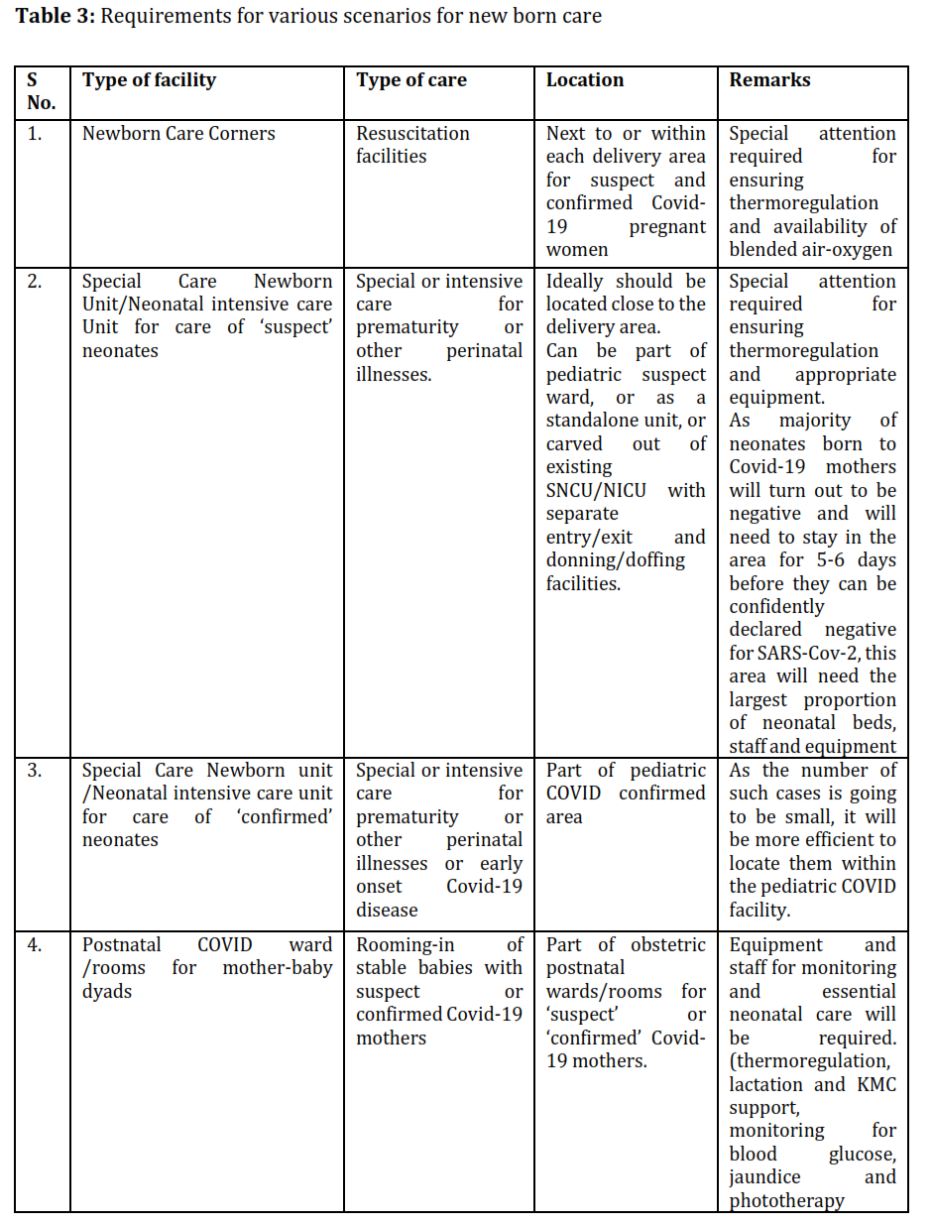

Slide 72
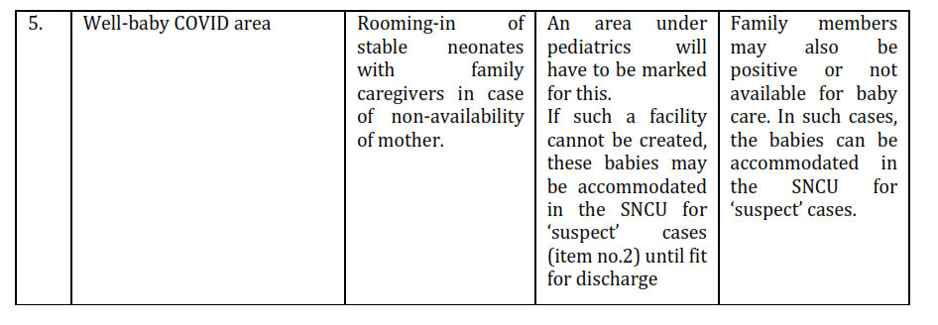
Practical tips: A separate SNCU nursery with separate exit, entry and staff area can be allotted for suspected/covid positive neonates where limitation of space for creating a separate facilities for covid neonates is not available
Management protocols for COVID neonates and infant is beyond scope of this presentation and will not be discussed here.

Slide 73
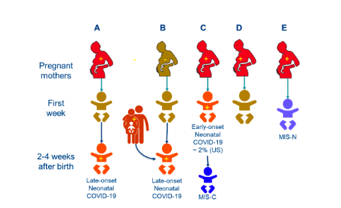
Neonatal Multisystem Inﬂammatory Syndrome (MIS-N)
Associated with Prenatal Maternal SARS-CoV-2: A Case Series
Children 2021, 8, 572 .https://doi.org/10.3390/children8070572https://www.mdpi.com/journal/childr
Various presentation of SARS-CoV-2 infection in neonate born to covid positive mother. Red color with+ signs presents COVID-19 positive mother
Pregnant mother E has COVID-19 disease or exposure to SARS-COV-2 during pregnancy and the baby develops multisystem inﬂammation secondary to passive transfer of antibodies leading to MIS-N (multisystem inﬂammatory syndrome in neonates

Slide 74
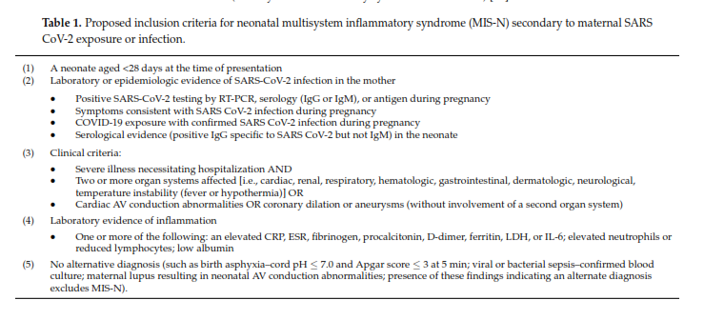
MIS-N: proposed inclusion Criterion

Slide 75
Long COVID Syndrome

Slide 76
Long Covid Syndrome and Chronic covid syndrome
National Institute for Health and Care Excellence (NICE) defines:
Long COVID or post-acute COVID (symptoms beyond 3 weeks) and Chronic post‐COVID syndrome (beyond 12 weeks) are multisystem syndromes
2 group of people :
1) with respiratory symptoms (breathlessness, cough) initially severe Covid
2) cluster of more general symptoms (tiredness, fatigue) larger group
AIG, Hyderabad and Max super specialty, Delhi survey showed that 40% patients have symptoms 1-3 months after covid, 32% have symptoms after 3 months and 11% still have symptoms 9-12 months after covid.
12.5% of recovered covid-19 patients have tiredness and fatigue
9.3% have myalgia
Many have neuropsychiatry symptoms like depression, forgetfulness (mental fog), anxiety etc

Slide 77
Long Covid & Chronic Covid Syndrome
Breathlessness alone- physiotherapy
Persistent Cough with/without breathlessness
Chronic Fatigue-no abnormality detected in tests. Cause: lung pathology does contribute to fatigue, post-viral fatigue also has a central phenomenon (inflammatory‐mediated and neurocognitive dysfunction),
Joint or muscle pain (myalgia)
Heart Palpitations: due to postural tachycardia syndrome, or postural orthostatic tachycardia syndrome (PoTS)
Headaches
Neuro-psychaitry symptoms:
difficulty sleeping anxiety and depression
heart palpitations chest tightness or pain
not being able to think straight or focus (‘brain fog’)
Change to sense of smell and taste

Slide 78
Long Covid Syndrome and Chronic covid syndrome
Individual's symptoms are related to the infection itself, treatments received or interaction with their chronic condition
Management involves-respiratory medicine, cardiology, rehabilitation medicine) and cognate disciplines (including physiotherapy, occupational therapy, psychology, speech and language therapy, and dietetics), Telerehabilitation
need a multifaceted approach to tackle the physical, cognitive, psychological, social, and vocational domains of this health condition.
Its presence in pediatric population is also noted- headaches, fatiguability are known. Exact incidence is not known yet.

Slide 79
Post-covid Pediatric Mucormycosis
Cases have been reported in India (Mumbai, Rajasthan) where children from age 6 yr to 14 yrs. have been diagnosed and treated for post covid mucormycosis.
5 cases being reported in Rajasthan (2 of them died after hospitalization)
History of diabetes with such cases is not consistent. Some children had no diabetes, some had developed diabetes post covid and some children were known diabetic cases.
Management have included- sinus debridement, enucleation of eyes along with six weeks of medicines like Amphotericn B with Posconazole was also done
A team of doctors including a paediatrician, paediatric ICU team, ENT surgeon, Ophthalmologist, Radiologist and ICU anaesthesia backup were needed to manage them.
https://www.hindustantimes.com/cities/jaipur-news/increase-in-mucormycosis-cases-among-rajasthan-children-concerning-doctors-101626686426399.html

Slide 80
COVID-19 vaccines
For children (India)

Slide 81
184 vaccines
32 vaccines
35 vaccine
25 vaccines
14 vaccines
4 vaccines
The COVID-19 VACCINE RACE
PRE- CLINICAL
PHASE 1
PHASE 2
PHASE 3
IN USE
PHASE 4
Are being explored in lab experiments and animals
Are undergoing safety tests in healthy young individuals
Are being tested in broader groups of people
Are in large international trials to test their impact on COVID-19
Are currently being offered to general population
Are being monitored in the wider population after being approved
COVID-19 vaccine types in development
Candidate in clinical phases I-III (as on 26/01/2021)
Whole virus= 15
Protein Subunit=13
Nucleic acid=2
Viral Vector= 15

Slide 82
Type of COVID-19 vaccines
Examples
COVAXIN
CORBOVAX, NOVOVAX
COVISHIELD, SPUTNIK-V
MODERNA, PFIZER
4 different type of vaccines
Whole virus
Protein Subunit
Viral Vector
Nucleic Acid (mRNA or DNA)

Slide 83
S. no. | Name of vaccine | Developed by | Country | Type of vaccine
1 | COVISHILED | Astrazenaca-Oxford | India | Viral Vector | In Use
2 | COVAXIN | Bharat Biotech | India | Inactivated Virus | In Use
3 | SPUTNIK-V | Gamaleya research institute | Russia | Viral Vector | In Use
4 | Moderna | Moderna-NIAID | USA | mRNA | Approved
5 | Janssen | Johnson-Johnson Barda Janssen | USA | Non replicating viral vector | Approved
6 | ZyCoV-D | Zydus-Cadilla | India | DNA-Palsmid based
7 | CORBEVAX | Biological E, Baylor College of Medicine, Dynavax | USA, India | Protein Subunit | Approved
8 | COVOVAX | Novavax, CEPI, Serum India | USA, INDIA |  | Approved
9 | BBC154 | Bharat Biotech, Precision Virologics, Washington University School of Medicine | USA, India | Intranasal | Phase III
10 | HGC019 | Gennova Biopharm, HDT Bio Corp and Dept. of Biotecnology India | USA, India | mRNA based | Phase III

Slide 84
COVID-19 vaccines in line for children
Covaxin
Bharat Biotech's Covaxin in an Indian vaccine developed by the Hyderabad-based vaccine maker and the Indian Council of Medical Research. While the vaccine is being administered to adults and has around 78 per cent efficacy. Now the vaccine is now approved for children between 15 to 18 years old.
Bharat Biotech's nasal vaccine (BBV154)
Bharat Biotech's one-shot nasal vaccine, which is believed to emerge as a game-changer, is already under trial. And since it's a nasal vaccine, making it very convenient for children's vaccination, the trial included children.

Slide 85
COVID-19 vaccines in line for children
Zydus Cadila's ZyCov-D
Zydus Cadila's ZyCov-D is another vaccine which is being tested on children belonging to the age group of 12 to 18, apart from adults. This vaccine will soon apply for licensure and when it gets cleared, the vaccine can be administered to children.
Novavax/Covavax
Novavax or Covavax will be the fourth vaccine to begin clinical trials for children in India. The vaccine has been developed by Novavax which has a tie-up with Pune's Serum Institute of India. The vaccine has overall efficacy of 90.4 per cent.
Moderna and Pfizer
Already Approved for children age 12-18 years. But not in India.

Slide 86
Prevention of Pediatric COVID
Wear masks
Keep Social Distancing
Wash your frequently

Slide 87
Coronavirus prevention
Q. Are children super-spreaders of the virus?
No. Children being super-spreaders is a myth. The latest studies have revealed that children are not super-spreaders of the virus. In fact, the capacity of children to spread the infection is much less as compared to adults.
Source: www.unicef.org/india

Slide 88
Prevention of COVID-19
• Transmission mainly through large droplets and less by droplet nuclei and Prevention still rests on the three basic principles
• Social distancing ( for children means stay at home as far as possible)
• Use of masks
• Not recommended in children below 2 yrs (5 yrs by WHO)
• Between 5-12 only after assessment of readiness to accept mask
• Beyond 12 as adults
• Three layered cloth masks are suitable ( N95 if having risk factors for COVID-19)
• Hand hygiene
• Emphasis on not delaying routine vaccination/ seeking medical care if sick
Vaccination- immunization against COVID-19 is effective. Most available vaccines in India giving 100% protection against severe covid to 80-90% against moderate covid and 70% against.

Slide 89
Guidelines for using masks
Masks are not recommended for children aged 5 years and under
Children aged 6-11 years may wear a mask depending on the ability of child to use a mask safely and appropriately under direct supervision of parents/guardians
Children aged 12 years and over should wear a mask under the same conditions as adults
Ensure hands are kept clean with soap and water, or an alcohol-based hand rub, while handling masks
GOI/ICMR/IAP guidelines June 2021

Slide 90
Guidelines for isolation
•
Infected children to be isolated with parents even if parents are
asymptomatic unless parent is high risk
If parents are positive, children should be isolated with them even if
children are asymptomatic
Should not be sent to grand parents or any body else’s house
Negative PCR test does not rule out infection that may be incubating
If asymptomatic contacts are to be tested then best tested after 5 days of last exposure
No need for repeating PCR to document negativity
Do isolation 7 days after positive test in mild disease and 20 days in case of severe disease
•
•
•
•
•
•

Slide 91
Future of covid pendemic
Covid Zero status is unlikely
Current Omicron wave could be beginning of the end of covid pandemic.
Small waves may come in future with new variants
‘Delmicron’ variant: not a new variant- it is presence of both Delta variant and Omicron Variant in same person. So, it will be a Killer like Delta variant and Rapid spreader like Omicron
Israel has reported its first case of 'flurona'— a simultaneous coronavirus and flu infection.
Yearly COVID vaccination may be a need in future
Notes:
It has been two years of covid pandemic now. Omicron is rapidly spreading but less pathogenic as per information till now.
It will infect more and more people and help developing natural immunity
New variants may be less and less fatal.

Slide 92
Summary
Children still fare better than adults
Most cases are Asymptomatic
Symptomatic care is all that is needed for the vast majority of cases
Isolation should be with parents
If symptoms are persistent then other causes apart from COVID need to be looked into
Steroids have to be used with caution
The diagnosis of MIS-C should be made after excluding other causes
Develop triage area in each centre for better management
Promote Paediatric COVID vaccination for those who are eligible

Slide 93
THANK YOU

